Slide 1
Open Adobe Photoshop CS5

Slide 2
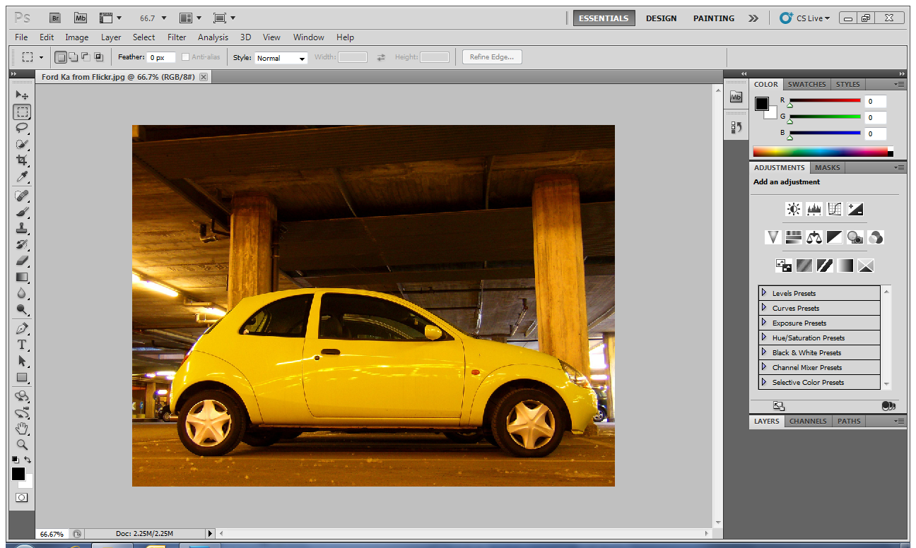
Open a car picture from Sir’s folder (Student Folder – ICT Folder – Mr Graham)

Slide 3
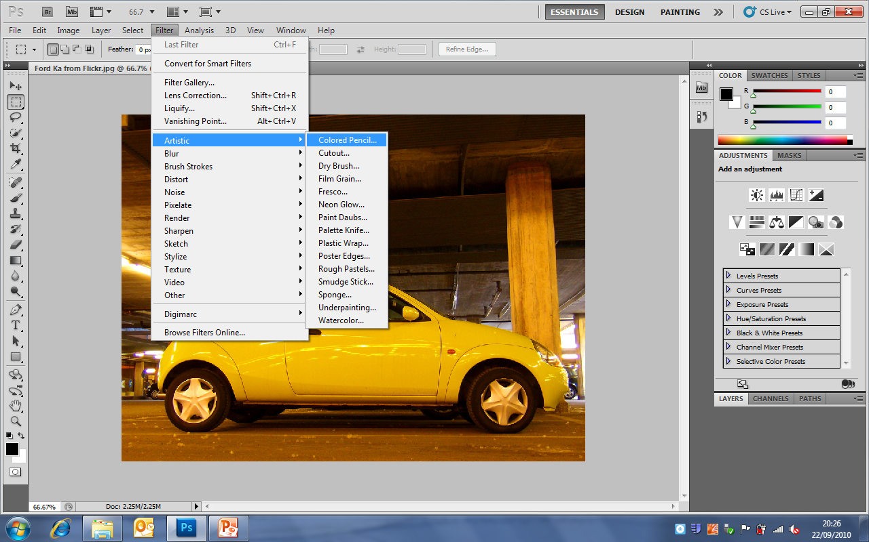
Select – Filter – Artistic – Coloured Pencil

Slide 4
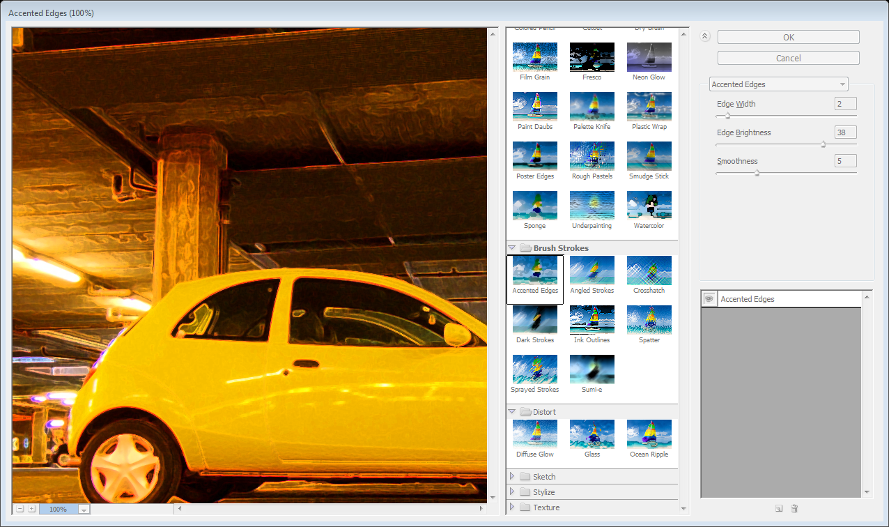
Try the different filters until you find one you like

Slide 5
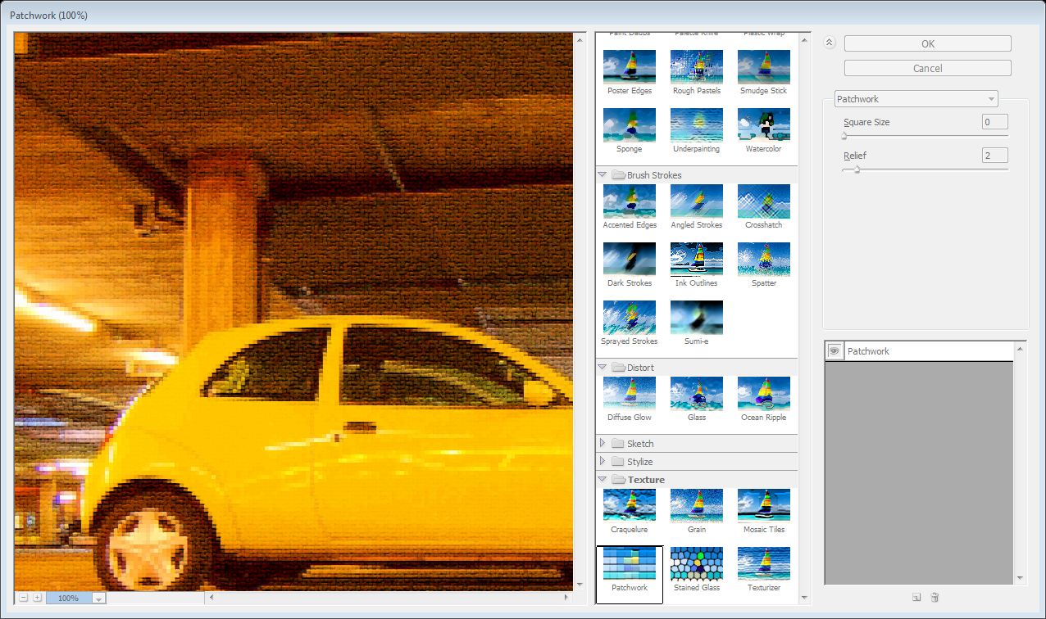
When you have a filter you like experiment with the settings

Slide 6
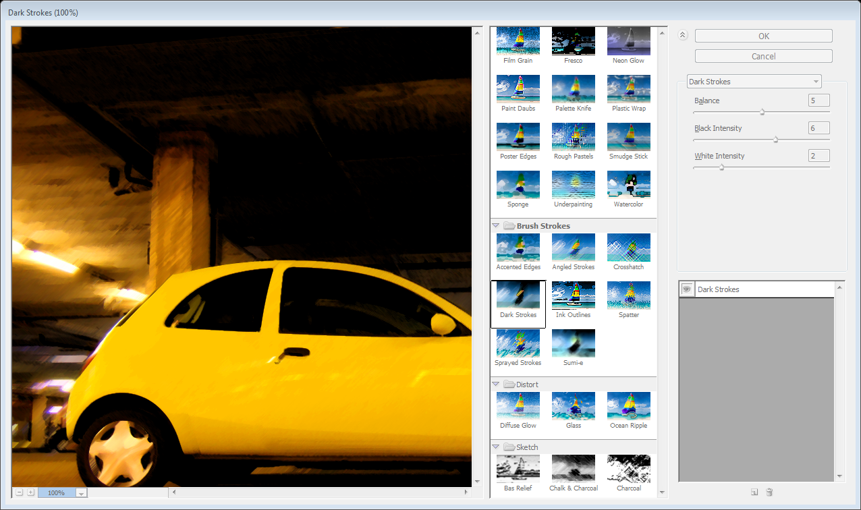
When you are happy click OK

Slide 7
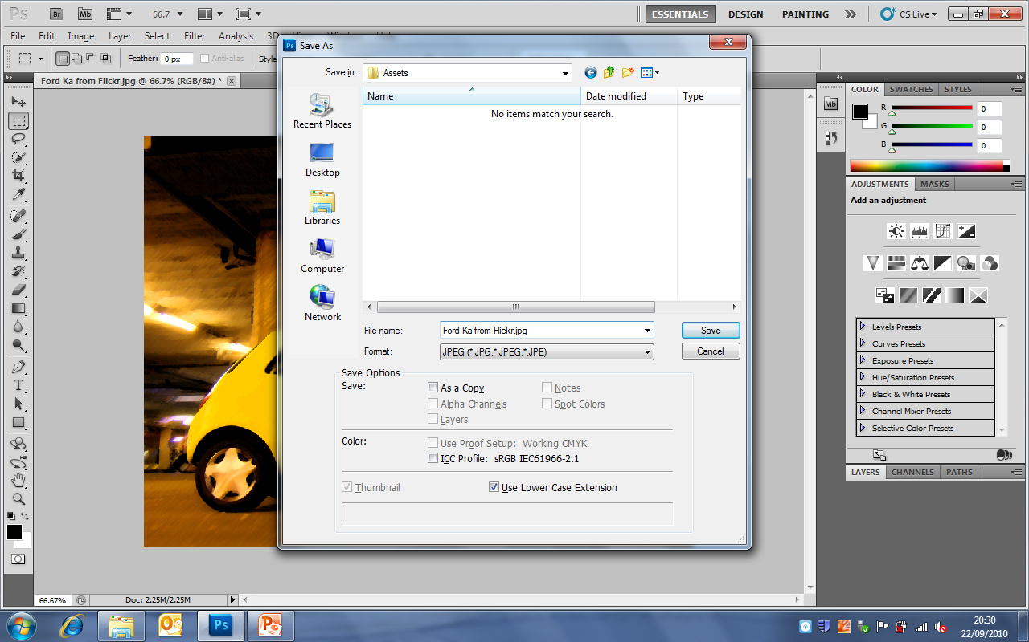
Go to File – Save as… - and put it in YOUR Assets folder

Slide 8
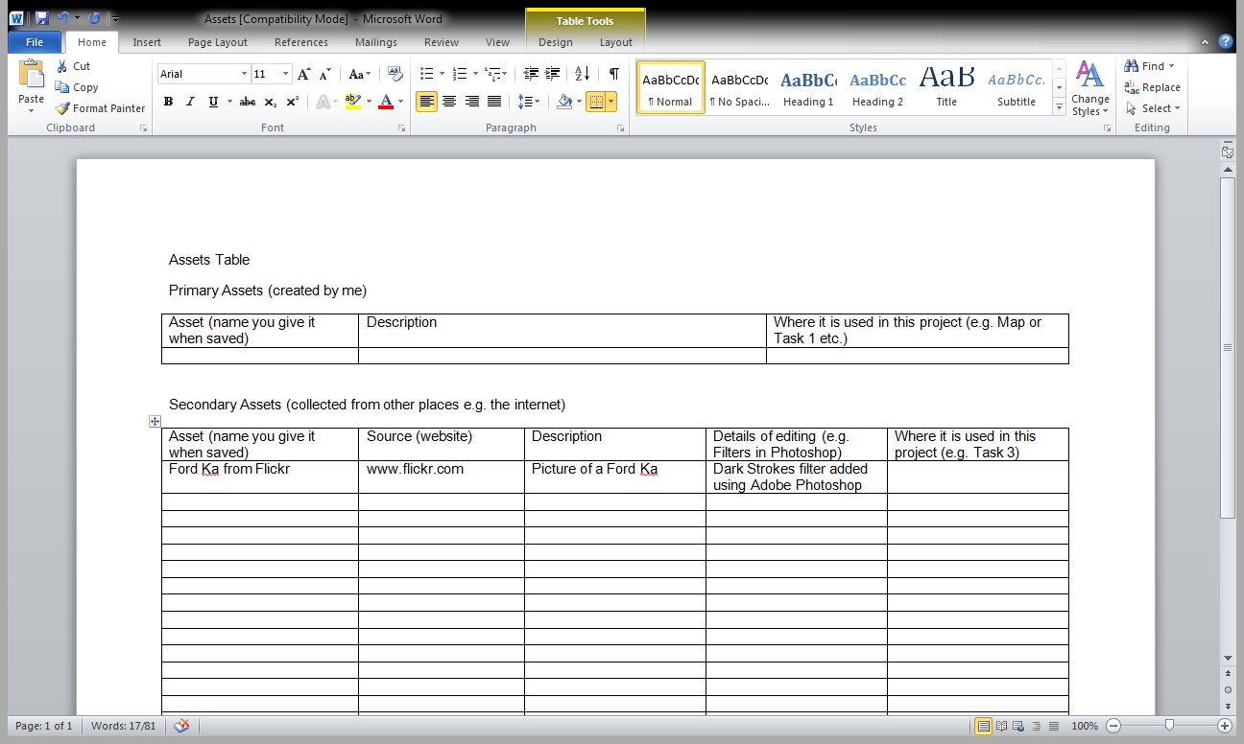
Add the file name, website and editing details into your Assets Table (copy the table from Sir if you don’t have one)

Slide 9
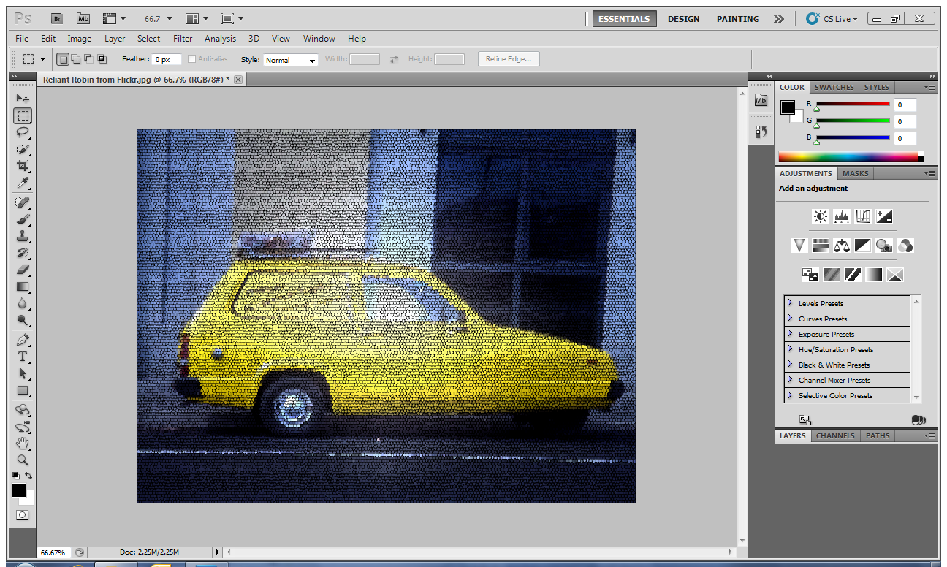
Then do another! You will need at least 6 car pictures edited

