Slide 1
Open PowerPoint and on the first slide have a message to introduce your movie

Slide 2
Create a new slide and put your movie title, e.g. Dream cars or history of cars

Slide 3
Create another new slide, insert a car picture you edited as a background
4. Select a picture from your Assets folder
2. Click picture…
3. Click File…
1. Right click, go to Format Background…

Slide 4
Use text boxes to insert your writing
Remember, you need some writing you can ask questions about at the end!

Slide 5
Do this for at least 6 slides of cars! (but no more than 10)

Slide 6
After, insert a slide to say the questions are next and then 3 more slides with your questions on

Slide 7
Insert Transitions e.g. Fade (how it moves from slide to slide)
1. Click Transitions
2. Pick a style

Slide 8
Make your movie play without clicking the mouse
1. Click Transitions
2. Take off ‘On Mouse Click’ and set ‘After’ to the number of seconds you want it on screen (e.g. 3)

Slide 9
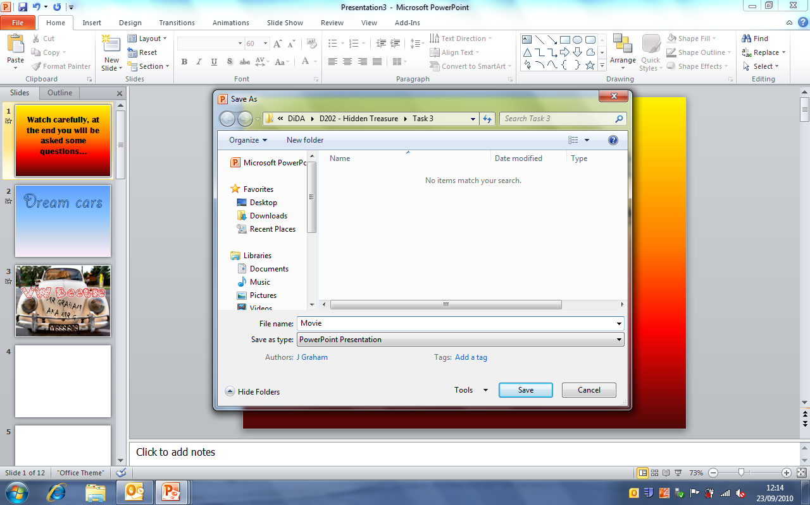
Save in your Task 3 folder as Movie

