Slide 1
We need some music for the start and end of our movie
Look in Student Folder -> Licence Free Music and Sounds
Copy your track into your DiDA -> Task 3 folder

Slide 2
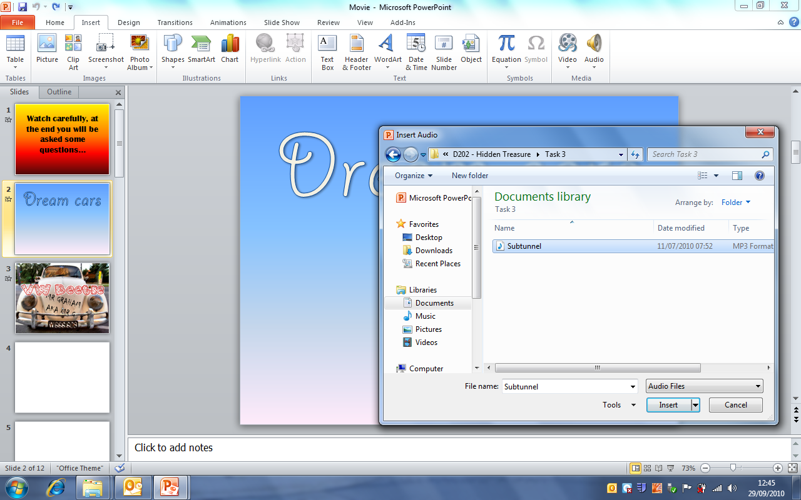
In your PowerPoint…
1. Click Insert
2. Click Audio
3. Find your track
4. Click Insert

Slide 3
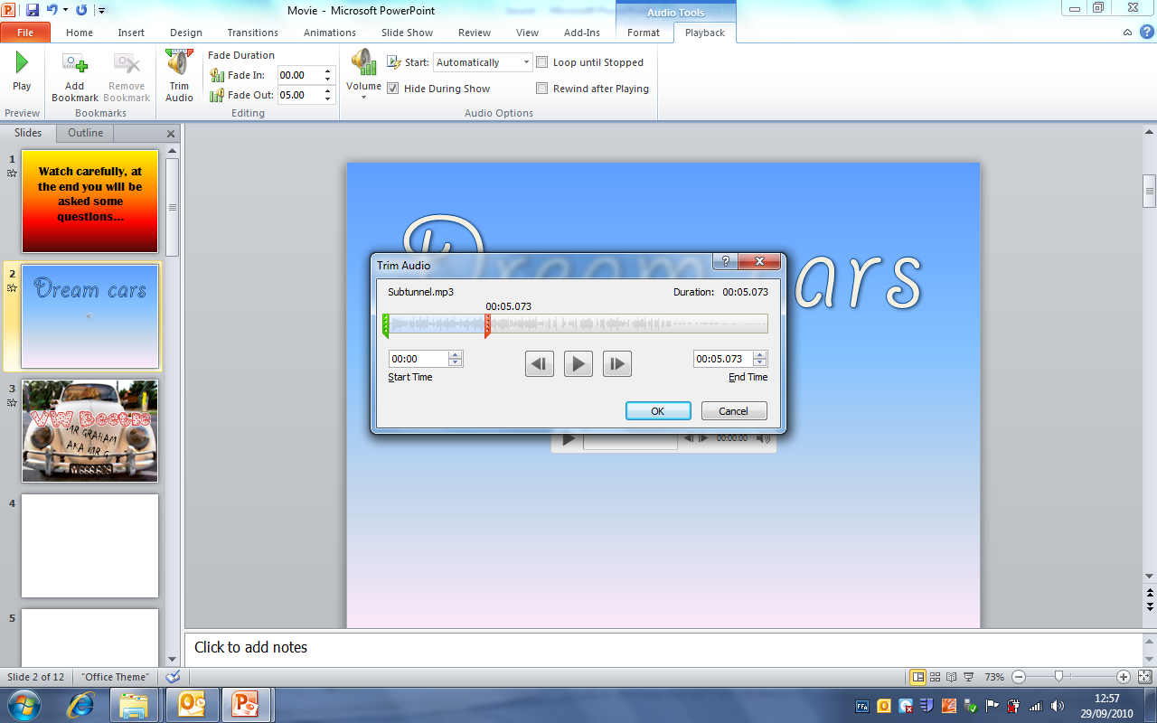
Make your track shorter
1. Click Playback
2. Click Trim Audio
3. Drag the start and end to a decent duration (track length) e.g. 5 seconds and click OK

Slide 4
Make it fade out, auto play and hide the icon…
1. Click Playback
2. Make it Fade Out so your track doesn’t just cut off. This time needs to be the same as whatever you’ve just made the track length e.g. 5 seconds
3. Set Start to Automatically and tick Hide During Show

Slide 5
Do the same for a track at the end, save and watch your movie!

